Slide 1

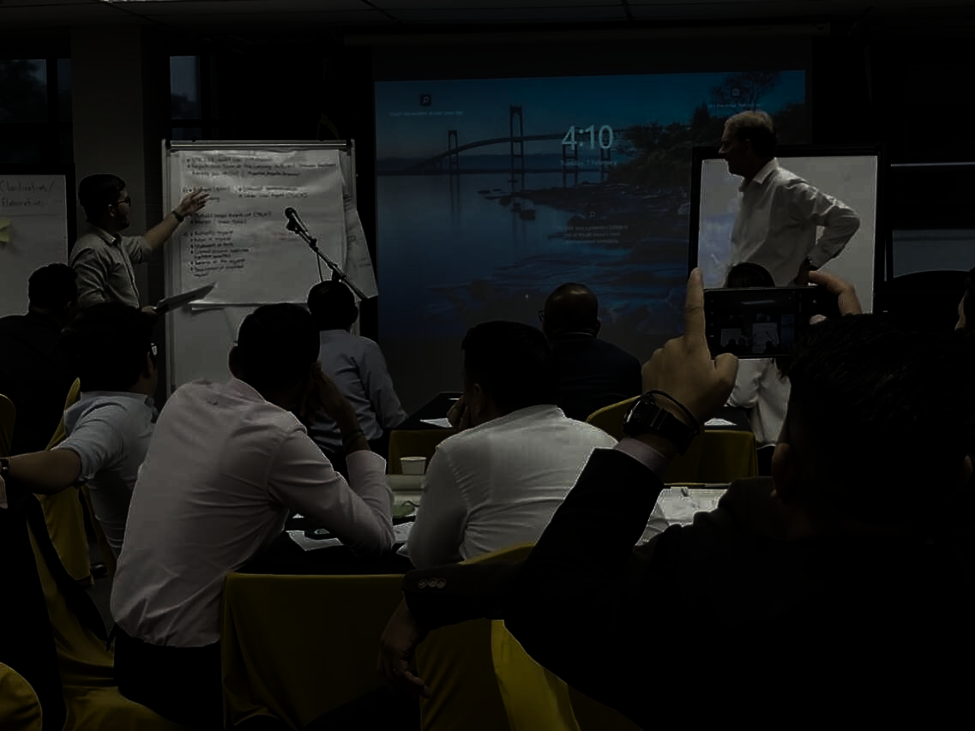



Investigation and Prosecution of Complex Corruption Cases
Level 1
3 – 6 February 2026
3.5 Days On-Site Training
REGISTER NOW
Malaysian Anti-Corruption Academy, Persiaran Tuanku Syed Sirajuddin, Bukit Tunku, 50480 Kuala Lumpur, Wilayah Persekutuan Kuala Lumpur

Slide 2

Our Training
Aims and objectives
Target Audience
This training is organized by United Nations Office on Drugs and Crime (UNODC) in partnership with the Malaysian Anti-Corruption Academy (MACA) in an effort to build the capacity of Malaysian law enforcement agencies and prosecutors to more effectively detect, investigate and prosecute cases related to transnational organized crime and corruption, in accordance with the law and with respect for human rights.
The investigation of economic and financial crime requires specific and specialised knowledge and skills, which need to be constantly updated to deal with evolving criminal practices.
Participants work as individuals, in small groups as investigation teams and in plenary discussion sessions through practical analysis of a multi-level case scenario that builds throughout the levels of the programme.
Agencies Note : Only the successful participants will be invited to attend Levels 2 and 3 in the future and cannot be substituted with participants who have not completed the prior Level
This programme has been implemented in countries and regions throughout the world and covers a range of thematic areas that arise in the investigation and prosecution of complex corruption cases, including:
Developing investigation strategy and planning
Collecting and analyzing financial evidence
Evidence charting and graphing, including using technology tools
Questioning witnesses and potential targets
Beneficial ownership
Working with cooperating offenders
Corruption in public procurement
Basic computer crime, digital evidence and Internet forensics
Blockchain, cryptocurrency and NFTs
Identification, targeting, freezing, seizure and confiscation of criminal assets
Law enforcement agencies, and departments specializing in financial scams, fraud, and transitional organized crime.
Deputy Public Prosecutors, Prosecution Officers, Digital Forensics and enforcement departments
Registration
Mr. Vijayarao a/l Sepermaniam
+ 603 6209 2846 /
+ 6012 919 9304
isc@sprm.gov.my / isc.maca@gmail.com
Don't miss this opportunity to participate and benefit from the expertise and knowledge exchange.

